Slide 1
BATTLE LANE
MRXSTE008 FLTTHE004

Slide 2
Completed Tasks
PvP Map including props and terrain
Basic Lightning
Basic Player/Hero Control
Basic AI, animation and attacks for “Footman” and “Lich” minion.
Basic AI, attacks for tower.
Win/Loss Conditions
UI: Basic healthbars and minimap.
Basic Particle Effects
Rough Sound

Slide 3
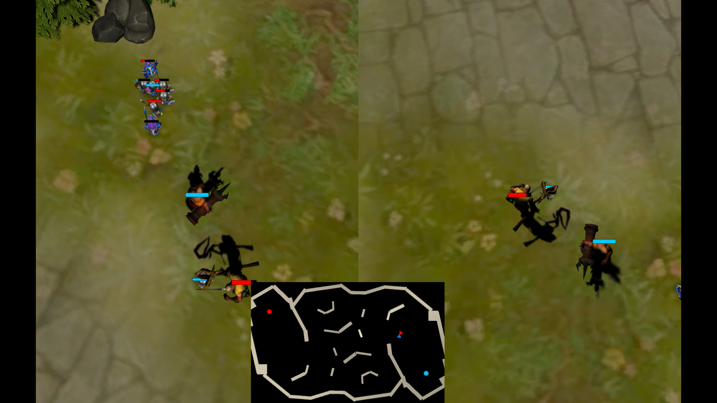
Known Bugs
Witch doctor attack animation sometimes doesn’t trigger.

Slide 4
Tasks To Do
Implement other AI minions (golem, orc, dragon, etc.)
Implement higher quality particles effects
Implement higher quality sound.
Implement power ups for Heroes.
Implement resource distribution, collection and minion purchasing.
Create UI menu system and options menu.
Polish UI elements.
Balance game mechanics.

